Slide 1
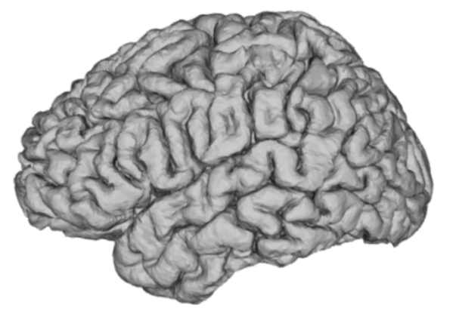
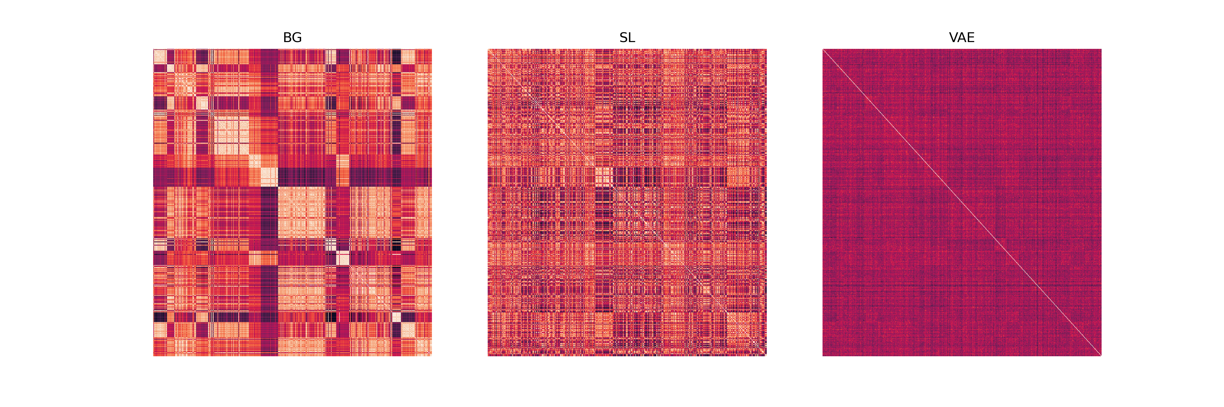
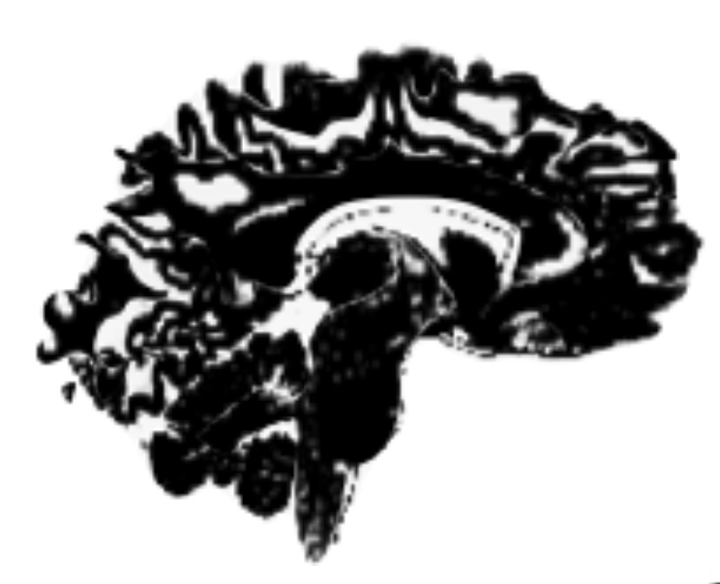
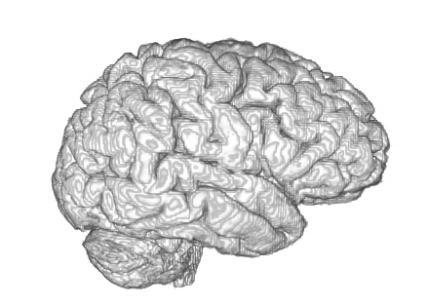
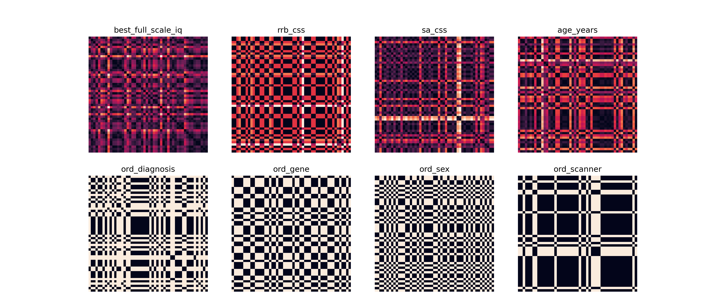
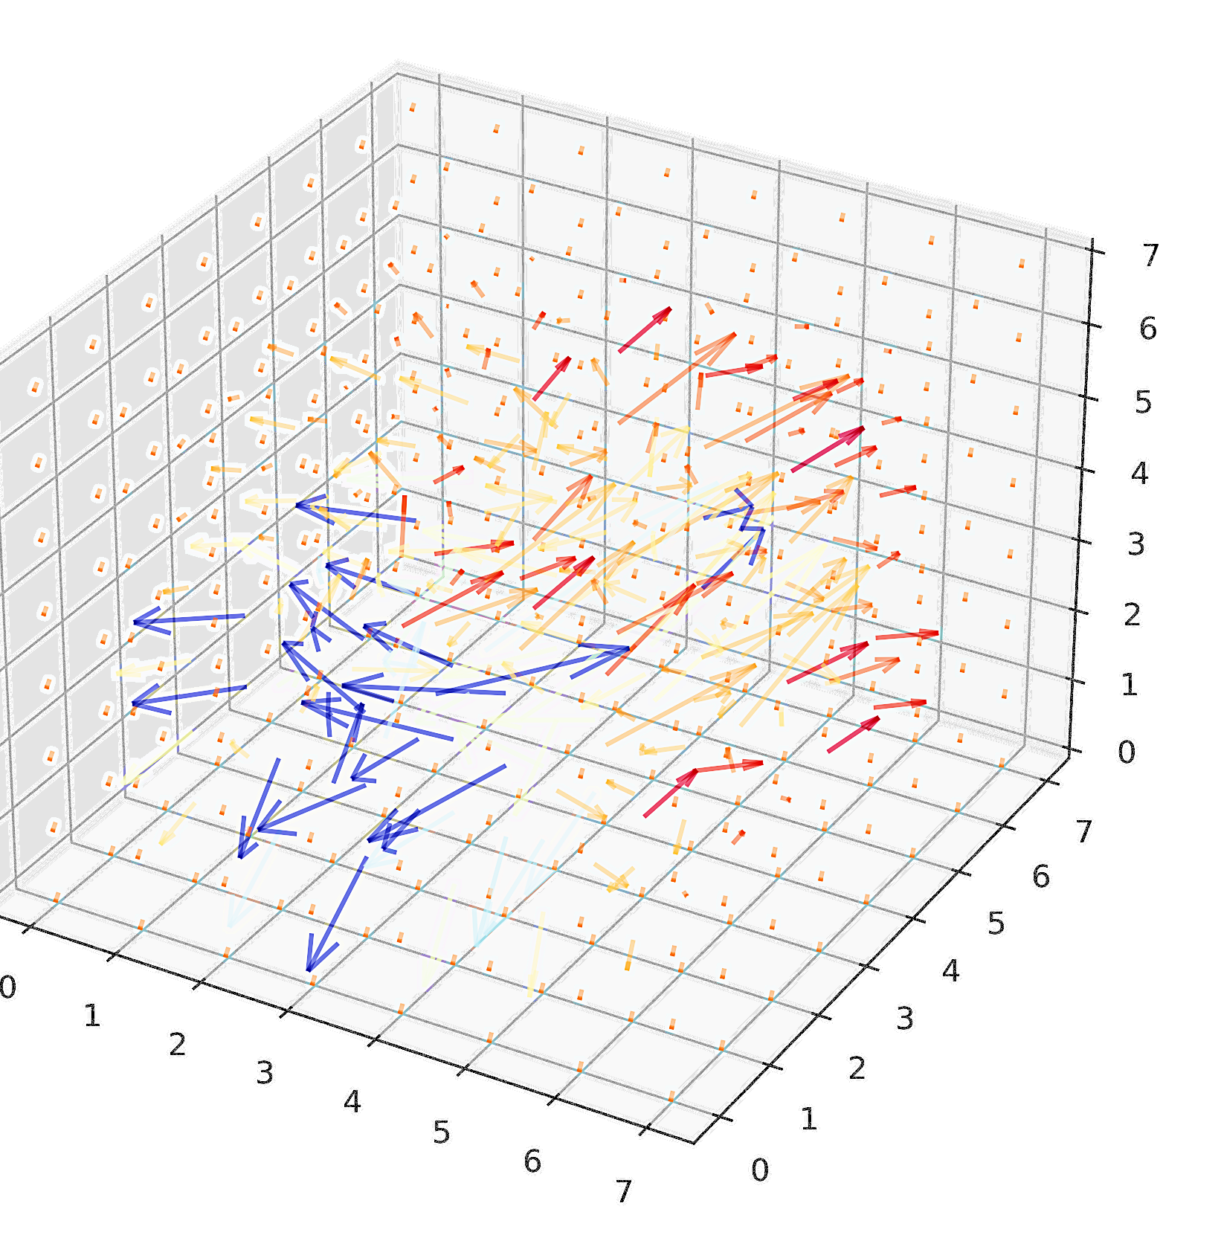
Data Preprocessing
Contrastive autoencoding
RSA analyses
Tensor-Based
morphometry
T1w image in native space
Data path for TD input
Data path for ASD input
ASD data input (N=470)
ASD brain
ASD brain
Tissue segmentation
𝝁_{j}
𝞼_{j}
𝝁_{k}
𝞼_{k}
𝝁_{j}
𝞼_{j}
0
0
Gray Matter
White Matter
Extract subject similarity
+
Shared
feature space
ASD-specific feature space
ASD reconstruction
Reconstruction of TD features only
Subjects
Subjects
Brain
Tissue
TD reconstruction
ASD reconstruction
Subjects
Subjects
Identification of ASD features
RSA models
ASD brain
TD features
Subject’s brain in Native space
(3D Volumetric view)
Convolutional
encoders
Convolutional decoder
IQ
ADOS RRB
ADOS SA
AGE
=
+
𝝁_{k}
𝞼_{k}
ASD-specific feature space
𝝁_{j}
𝞼_{j}
ASD/TD shared feature space
DSM- IV
Genotype
Gender
Scanner
Spatial normalization TD -> ASD

